Slide 1
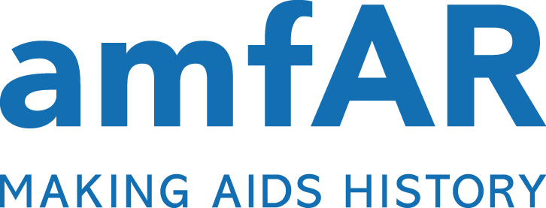
Syringe Services Programs
Myth vs. FACT

Slide 2
Ten Myths Surrounding
Syringe Services Programs (SSPs)
Myth 1: Syringe Services Programs (SSPs) only give out needles.
Myth 2: SSPs increase injection drug use and undermine public safety.
Myth 3: Supporting injection drug users is not an efficient use of public resources.
Myth 4: Injection drug use is limited and a problem of the past.
Myth 5: HIV impacts all injection drug users equally, regardless of race or ethnicity.
Myth 6: SSPs do not enjoy broad popular and professional support.
Myth 7: Lifting the ban on federal funding in 2009 did not make a difference.
Myth 8: Lifting the current ban on federal funding will not make a difference.
Myth 9: Support of SSPs is unrealistic given the current fiscal crisis.
Myth 10: Due to the success of SSPs, our work is done.
Syringe Services Programs: Myth vs. Fact
Notes:
Note: when viewing in slide show mode, the myth #s are clickable links to the associated slides

Slide 3



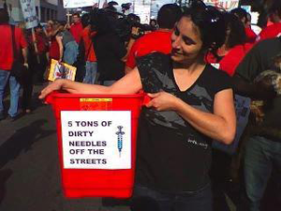
Syringe Services Programs (SSPs) only give out needles
SSPs provide a variety of syringe exchange services throughout the country
SSPs distribute free sterile syringes to injection drug users (IDUs), which reduces the likelihood that users will share injecting equipment.¹
SSPs safely dispose of used needles, a service not typically provided by distributors such as pharmacies.
SSPs make neighborhoods safer by reducing needle-stick injuries.¹
SSPs operate in 166 cities in 30 states, the District of Columbia, Puerto Rico, and Indian Nations.²
¹amfAR, Federal Funding for Syringe Services Programs: Saving Money, Promoting Public Safety, and Improving Public Health. Available at: http://www.amfar.org/uploadedFiles/_amfarorg/Articles/On_The_Hill/2013/issue-brief-federal-funding-for-syringe-service-programs.pdf.
²amfAR Syringe Exchange Program Coverage Map. Available from: Available at: http://www.amfar.org/uploadedFiles/_amfarorg/Articles/In_The_Community/2013/July%202013%20SEP%20Map%20.pdf
Syringe Services Programs: Myth vs. Fact
Notes:
¹amfAR, Federal Funding for Syringe Services Programs: Saving Money, Promoting Public Safety, and Improving Public Health. Available at: http://www.amfar.org/uploadedFiles/_amfarorg/Articles/On_The_Hill/2013/issue-brief-federal-funding-for-syringe-service-programs.pdf.
²amfAR Syringe Exchange Program Coverage Map. Available from: Available at: http://www.amfar.org/uploadedFiles/_amfarorg/Articles/In_The_Community/2013/July%202013%20SEP%20Map%20.pdf

Slide 4
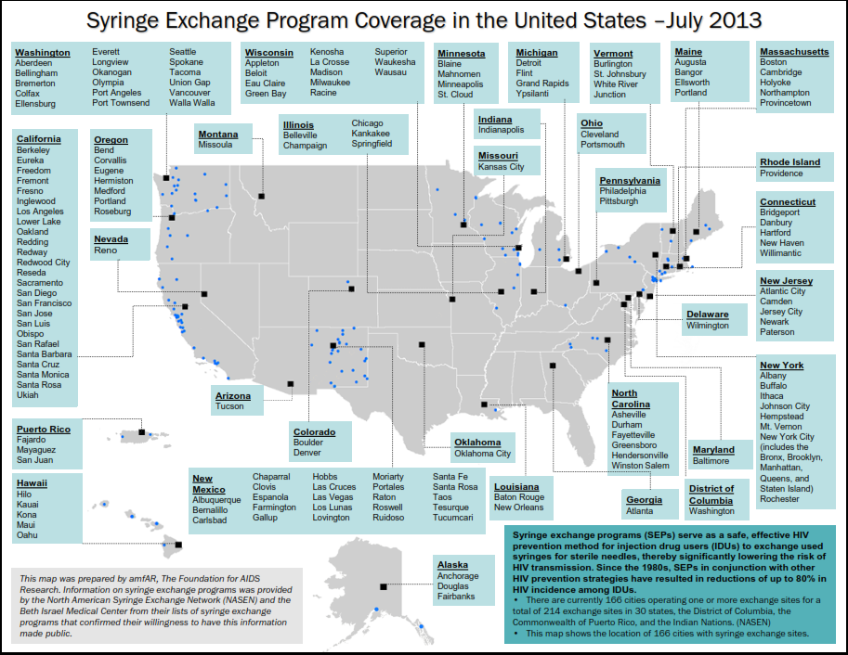
Available from: http://www.amfar.org/uploadedFiles/_amfarorg/Articles/In_The_Community/2013/July%202013%20SEP%20Map%20.pdf
Syringe Services Programs: Myth vs. Fact
Notes:
Available from: http://www.amfar.org/uploadedFiles/_amfarorg/Articles/In_The_Community/2013/July%202013%20SEP%20Map%20.pdf

Slide 5
Syringe Services Programs (SSPs) only give out needles
SSPs provide a variety of syringe exchange services throughout the country
In Baltimore, SSPs helped reduce the number of improperly discarded syringes by almost 50%. ¹
In Portland, Oregon, the implementation of SSPs reduced the number of improperly discarded syringes by two-thirds.²
In 2008 and 2009, Miami (which had no SSPs) saw eight times more improperly disposed syringes than San Francisco (where SSPs are available) despite the fact that San Francisco is thought to have twice as many IDUs.³
¹Doherty, M.C., Junge, B., Rathouz, P., Garfein, R.S., Riley, E., & Vlahov, D. (2000). The effect of a needle exchange program on numbers of discarded needles: A 2-year follow-up. American Journal of Public Health, 90(6), 936-939.
²Oliver, K.J., Friedman, S.R., Maynard, H., Magnuson, L., & Des Jarlais, D.C. (1992). Impact of a needle exchange program on potentially infectious syringes in public places. Journal of Acquired Immune Deficiency Syndromes, 5, 534–535.
³Tookes, H.E., et al. (2012). A comparison of syringe disposal practices among injection drug users in a city with versus a city without needle and syringe programs. Drug and Alcohol Dependence, 123(1-3), 255-9.
Syringe Services Programs: Myth vs. Fact
Notes:
¹Doherty, M.C., Junge, B., Rathouz, P., Garfein, R.S., Riley, E., & Vlahov, D. (2000). The effect of a needle exchange program on numbers of discarded needles: A 2-year follow-up. American Journal of Public Health, 90(6), 936-939.
²Oliver, K.J., Friedman, S.R., Maynard, H., Magnuson, L., & Des Jarlais, D.C. (1992). Impact of a needle exchange program on potentially infectious syringes in public places. Journal of Acquired Immune Deficiency Syndromes, 5, 534–535.
³Tookes, H.E., et al. (2012). A comparison of syringe disposal practices among injection drug users in a city with versus a city without needle and syringe programs. Drug and Alcohol Dependence, 123(1-3), 255-9.

Slide 6
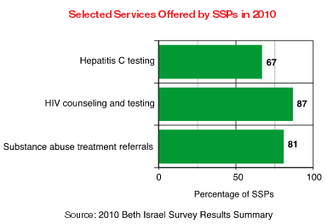
Syringe Services Programs (SSPs) only give out needles
SSPs provide a variety of services in addition to syringe exchange¹
Selected Services Offered by SSPs Nationwide in 2010
Onsite medical care ¹
Screening and counseling for HIV, hepatitis C, and STIs (injection drug users are twice as likely as the general public not to know their HIV status) ^{1,2}
Distribution of safer sex supplies, food, and clothing ¹
Referrals to substance use treatment and support groups ¹
Medications and resources to prevent death from drug overdose ³
Case management
¹Des Jarlais, D.C., Guardino, V., Nugent, A., Arasteh, K., & Purchase, D. (2012). (unpublished data) 2010 National Survey of Syringe Exchange Programs: Summary of Results. North American Syringe Exchange Network. Available at: http://nasen.org/news/2012/jul/05/2010-beth-israel-survey-results-summary/.
²National Minority AIDS Council. Federal funding for syringe exchange. Available from: harmreduction.org/wp-content/uploads/2012/01/Syringe-Exchange-June-4-NMAC.pdf
³Des Jarlais, D.C., Guardino, V., Nugent, A., Arasteh, K., & Purchase, D. 2011 National Survey of Syringe Exchange Programs: Summary of Results. Presented at the 9th National Harm Reduction Conference: “From Public Health to Social Justice,” Portland, OR, November, 2012.
Syringe Services Programs: Myth vs. Fact
Notes:
¹Des Jarlais, D.C., Guardino, V., Nugent, A., Arasteh, K., & Purchase, D. (2012). (unpublished data) 2010 National Survey of Syringe Exchange Programs: Summary of Results. North American Syringe Exchange Network. Available at: http://nasen.org/news/2012/jul/05/2010-beth-israel-survey-results-summary/.
²National Minority AIDS Council. Federal funding for syringe exchange. Available from: harmreduction.org/wp-content/uploads/2012/01/Syringe-Exchange-June-4-NMAC.pdf
³Des Jarlais, D.C., Guardino, V., Nugent, A., Arasteh, K., & Purchase, D. 2011 National Survey of Syringe Exchange Programs: Summary of Results. Presented at the 9th National Harm Reduction Conference: “From Public Health to Social Justice,” Portland, OR, November, 2012.

Slide 7
SSPs increase injection drug use and undermine public safety
Statistics show that SSP services improve public health and safety
In New York City, the growth of SSPs from 1990 to 2001 was associated with a 78% decrease in HIV prevalence among IDUs. ¹
During this time period, the same population saw a decrease in the prevalence of hepatitis C from 90% to 63% ²
One study showed that within 6 months of using federally-funded SSPs, clients saw a 45% increase in employment. In addition, clients were 25% more likely to have been successfully referred to mental health treatment and prescribed medication.³
In New Jersey, 22% of the state’s SSP clients have entered drug treatment.⁴
¹Des Jarlais, DC, et al. (2005). HIV Incidence Among Injection Drug Users in New York City, 1990 to 2002: Use of Serologic Test Algorithm to Assess Expansion of HIV Prevention Services. American Journal of Public Health 95.8: 1439-444.
²Des Jarlais, D.C., et al. (2005). Reductions in hepatitis C virus and HIV infections among injecting drug users in New York City, 1990-2001. AIDS, 19(suppl 3), S20-S25.
³Silverman, B., Thompson, D., Baxter, B., Jimenez, A.D., Hart, C., & Hartfield, C. (July 25, 2012). First federal support for community based syringe exchange programs: A panel presentation by SAMHSA grantees (Poster--WEPE234). Presented at the International AIDS Conference Poster Session, Washington, D.C. Poster and abstract available online at http://pag.aids2012.org/abstracts.aspx?aid=20133. (date last accessed: December 12, 2012).
⁴New Jersey Syringe Access Program Demonstration Project. (January 2010). Interim report: Implementation of P.L. 2006, c.99, “Blood-borne Disease Harm Reduction Act.” Available online at http://www.state.nj.us/health/aids/documents/nj_sep_evaluation.pdf. (date last accessed: December 12, 2012).
Syringe Services Programs: Myth vs. Fact
Notes:
¹Des Jarlais, DC, et al. (2005). HIV Incidence Among Injection Drug Users in New York City, 1990 to 2002: Use of Serologic Test Algorithm to Assess Expansion of HIV Prevention Services. American Journal of Public Health 95.8: 1439-444.
²Des Jarlais, D.C., et al. (2005). Reductions in hepatitis C virus and HIV infections among injecting drug users in New York City, 1990-2001. AIDS, 19(suppl 3), S20-S25.
³Silverman, B., Thompson, D., Baxter, B., Jimenez, A.D., Hart, C., & Hartfield, C. (July 25, 2012). First federal support for community based syringe exchange programs: A panel presentation by SAMHSA grantees (Poster--WEPE234). Presented at the International AIDS Conference Poster Session, Washington, D.C. Poster and abstract available online at http://pag.aids2012.org/abstracts.aspx?aid=20133. (date last accessed: December 12, 2012).
⁴New Jersey Syringe Access Program Demonstration Project. (January 2010). Interim report: Implementation of P.L. 2006, c.99, “Blood-borne Disease Harm Reduction Act.” Available online at http://www.state.nj.us/health/aids/documents/nj_sep_evaluation.pdf. (date last accessed: December 12, 2012)

Slide 8
SSPs increase injection drug use and undermine public safety
SSPs connect IDUs with treatment and are associated with reduced crime
Neighborhoods in Baltimore with SSPs experienced an 11% decrease in break-ins and burglaries, while areas without SSPs saw an 8% increase in such crimes during the same period.¹
In Seattle, IDUs who had used SSPs were more likely to report a significant decrease (>75%) in injection drug use, to stop using injection drugs, and to remain in treatment than IDUs who had never used SSPs.²
The same study in Seattle found that new users of the SSP were five times more likely to enter drug treatment than individuals who never utilized the program.²
¹Center for Innovative Public Policies. Needle Exchange Programs: Is Baltimore a Bust? Tamarac, Fl.: CIPP; April 2001.
²Hagan, H. et al. (2000). Reduced injection frequency and increased entry and retention in drug treatment associated with needle-exchange participation in Seattle drug injectors. Journal of Substance Abuse Treatment, 19, 247-252.
Syringe Services Programs: Myth vs. Fact
Notes:
¹Center for Innovative Public Policies. Needle Exchange Programs: Is Baltimore a Bust? Tamarac, Fl.: CIPP; April 2001.
²Hagan, H. et al. (2000). Reduced injection frequency and increased entry and retention in drug treatment associated with needle-exchange participation in Seattle drug injectors. Journal of Substance Abuse Treatment, 19, 247-252.

Slide 9
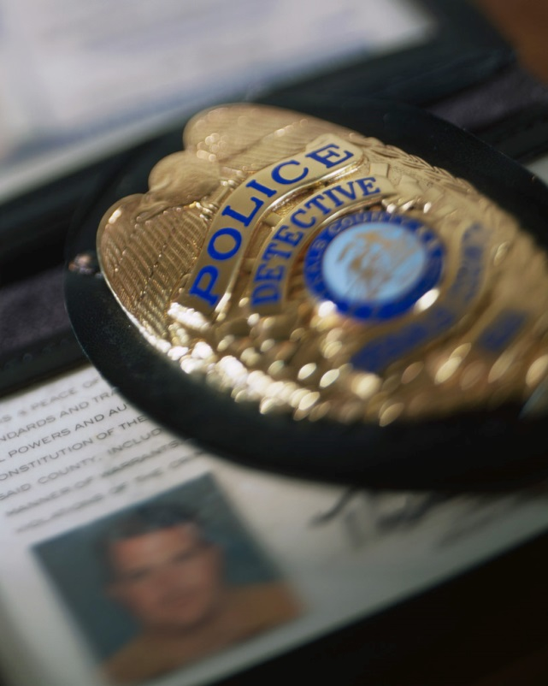
SSPs increase injection drug use and undermine public safety
SSPs promote public safety
Needle stick injuries to law enforcement are a common occurrence. In San Diego, nearly 30% of officers have been stuck by a needle.¹
Decriminalization of syringes (and SSPs) has been tied to reduced needle stick injuries. In South Carolina, where syringes are legal, officers have experienced needle stick injuries at half the rate of their counterparts in North Carolina, where syringes are illegal.²
In Connecticut, police officer needle stick injuries were reduced by two-thirds after the establishment of SSPs.³
¹Lorentz, J., Hill, J., & Samini, B. (2000). Occupational needle stick injuries in a metropolitan police force. American Journal of Preventive Medicine, 18, 146–150.
²NCHRC. NC Study Reveals that Law Enforcement Want to Reform Paraphernalia Laws. Available at http://www.nchrc.org/law-enforcement/north-carolina-law-enforcement-attitudes-towards-syringe-decriminalization/
³Groseclose, S.L., Weinstein, B., Jones, T.S., Valleroy, L.A., Fehrs, L.J., & Kassler, W.J. (1995). Impact of increased legal access to needles and syringes on practices of injecting-drug users and police officers- Connecticut, 1992-1993. Journal of Acquired Immune Deficiency Syndromes & Human Retrovirology 10(1): 82-89.
Syringe Services Programs: Myth vs. Fact
Notes:
¹Lorentz, J., Hill, J., & Samini, B. (2000). Occupational needle stick injuries in a metropolitan police force. American Journal of Preventive Medicine, 18, 146–150.
²NCHRC. NC Study Reveals that Law Enforcement Want to Reform Paraphernalia Laws. Available at http://www.nchrc.org/law-enforcement/north-carolina-law-enforcement-attitudes-towards-syringe-decriminalization/
³Groseclose, S.L., Weinstein, B., Jones, T.S., Valleroy, L.A., Fehrs, L.J., & Kassler, W.J. (1995). Impact of increased legal access to needles and syringes on practices of injecting-drug users and police officers- Connecticut, 1992-1993. Journal of Acquired Immune Deficiency Syndromes & Human Retrovirology 10(1): 82-89.

Slide 10
SSPs increase injection drug use and undermine public safety
SSPs promote public safety
Expert Observation:
“In the cities that have adopted needle services programs, there is a dramatic reduction in needle sticks to firefighters who crawl on their hands and knees through smoke-filled rooms in search of victims.”
- Charles Aughenbaugh, Jr., President, New Jersey Deputy Fire Chiefs Association, Retired Deputy Fire Chief, March 2011
Syringe Services Programs: Myth vs. Fact

Slide 11
Supporting injection drug users is not an efficient use of public resources
We can save money by alleviating IDU reliance on public sector resources¹
HIV-positive IDUs often rely on Medicaid, Medicare, or Ryan White programs for their health care. This means that taxpayers will bear the lion’s share of treatment costs associated with new infections related to drug use.¹
The lifetime cost of treating an HIV-positive person is estimated to be between $385,200 and $618,900.²
With needles and syringes costing less than 50 cents each, it is far cheaper to prevent a new case of HIV than to assume many years of treatment costs.¹
¹amfAR, Federal Funding for Syringe Services Programs: Saving Money, Promoting Public Safety, and Improving Public Health. Available at: http://www.amfar.org/uploadedFiles/_amfarorg/Articles/On_The_Hill/2013/issue-brief-federal-funding-for-syringe-service-programs.pdf.
²Schackman, B.R., Gebo, K. A., & Walensky, R.P. et al. (2006). The lifetime cost of current Human Immunodeficiency Virus care in the United States. Medical Care, 44(11), 990-997.
Syringe Services Programs: Myth vs. Fact
Notes:
¹amfAR, Federal Funding for Syringe Services Programs: Saving Money, Promoting Public Safety, and Improving Public Health. Available at: http://www.amfar.org/uploadedFiles/_amfarorg/Articles/On_The_Hill/2013/issue-brief-federal-funding-for-syringe-service-programs.pdf.
²Schackman, B.R., Gebo, K. A., & Walensky, R.P. et al. (2006). The lifetime cost of current Human Immunodeficiency Virus care in the United States. Medical Care, 44(11), 990-997.

Slide 12
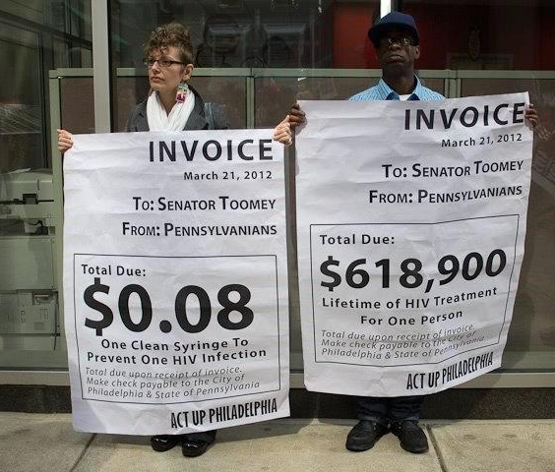
Supporting injection drug users is not an efficient use of public resources
SSPs are highly cost-effective
Every dollar invested in SSPs results in
$3-7 in savings
just by preventing new HIV infections.¹
¹Nguyen, T. Q., Weir, B. W., Pinkerton, S. D., Des Jarlais, D.C., & Holtgrave, D. (2012). Increasing investment in syringe exchange is cost-saving HIV prevention: modeling hypothetical syringe coverage levels in the United States (MOAE0204). Presented at the XIX International AIDS Conference, Washington, D.C. Session available online at http://pag.aids2012.org/PAGMaterial/PPT/1064_1420/tnsepcostsavingiac2012.pptx.
Syringe Services Programs: Myth vs. Fact
Notes:
¹Nguyen, T. Q., Weir, B. W., Pinkerton, S. D., Des Jarlais, D.C., & Holtgrave, D. (2012). Increasing investment in syringe exchange is cost-saving HIV prevention: modeling hypothetical syringe coverage levels in the United States (MOAE0204). Presented at the XIX International AIDS Conference, Washington, D.C. Session available online at http://pag.aids2012.org/PAGMaterial/PPT/1064_1420/tnsepcostsavingiac2012.pptx.

Slide 13
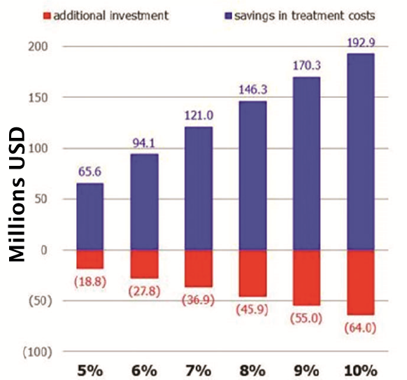
Supporting injection drug users is not an efficient use of public resources
SSPs are highly cost-effective
Positive impact of funding SSPs¹
A recent study has shown that an investment of $64 million would result in an estimated
$193 million in savings
by preventing 500 new HIV infections.¹
¹Nguyen, T. Q., Weir, B. W., Pinkerton, S. D., Des Jarlais, D.C., & Holtgrave, D. (2012). Increasing investment in syringe exchange is cost-saving HIV prevention: modeling hypothetical syringe coverage levels in the United States (MOAE0204). Presented at the XIX International AIDS Conference, Washington, D.C. Session available online at http://pag.aids2012.org/Abstracts.aspx?SID=198&AID=17268.
SSP syringe coverage
Syringe Services Programs: Myth vs. Fact
Notes:
¹Nguyen, T. Q., Weir, B. W., Pinkerton, S. D., Des Jarlais, D.C., & Holtgrave, D. (2012). Increasing investment in syringe exchange is cost-saving HIV prevention: modeling hypothetical syringe coverage levels in the United States (MOAE0204). Presented at the XIX International AIDS Conference, Washington, D.C. Session available online at http://pag.aids2012.org/Abstracts.aspx?SID=198&AID=17268.

Slide 14

Supporting injection drug users is not an efficient use of public resources
SSPs are highly cost-effective
Between 2001 and 2011, Illinois saw a drop of nearly two-thirds in new HIV cases among IDUs, averting an estimated $200 million in medical expenses.¹
In Massachusetts, there was a 54% decrease in new HIV diagnosis between 1999 and 2012, preventing 5,699 infections and saving more than $2 billion in health care costs.²
King County (Washington State) spent $1.1 million on SSPs in 2008. If HIV was prevented among only 1% of IDUs in King County, the resulting savings in HIV treatment costs will be $70 million.³
¹AIDS Foundation of Chicago. AFC Statement on Federal Funding Ban for Syringe Exchanges. Retrieved from: http://www.aidschicago.org/national-news/416-afc-statement-on-federal-funding-ban-for-syringe-exchanges.
²AIDS Action Committee. President Obama’s Fiscal 2013 Budget Demonstrates Commitment To Ending HIV/AIDS Epidemic In America. Available at: http://www.aac.org/media/releases/president-obamas-fiscal-2013.html.
³Public Health – Seattle & King County Needle Exchange Program. Available at: http://www.kingcounty.gov/healthservices/health/communicable/hiv/resources/aboutnx.aspx.
Syringe Services Programs: Myth vs. Fact
Notes:
¹AIDS Foundation of Chicago. AFC Statement on Federal Funding Ban for Syringe Exchanges. Retrieved from: http://www.aidschicago.org/national-news/416-afc-statement-on-federal-funding-ban-for-syringe-exchanges.
²AIDS Action Committee. President Obama’s Fiscal 2013 Budget Demonstrates Commitment To Ending HIV/AIDS Epidemic In America. Available at: http://www.aac.org/media/releases/president-obamas-fiscal-2013.html.
³Public Health – Seattle & King County Needle Exchange Program. Available at: http://www.kingcounty.gov/healthservices/health/communicable/hiv/resources/aboutnx.aspx.

Slide 15
Injection drug use is limited and a problem of the past
Injection drug use is expanding among non-traditional drugs such as prescription drugs¹
Individuals using prescription drugs nonmedically may turn to injection as a more efficient method of drug delivery.¹ Additionally, the high cost of prescription drugs and crackdown on prescription drug use can cause IDUs to transition to heroin use.²
A recent report by the Substance Abuse and Mental Health Services Administration (SAMHSA) showed that those who reported prior use of nonmedical pain relievers were 19 times more likely to have recently begun using heroin than those who had not used nonmedical pain relievers. The report also showed that 79.5% of people who recently began using heroin had previously used prescription drugs for nonmedical purposes.³
Heroin use has increased dramatically nationwide in the past several years. Whereas in 2007, SAMHSA reported there to be 373,000 recent heroin users in the US, this number jumped to 669,000 in 2012.⁴
SSPs play an important role in addressing the needs of new IDUs. Other outlets for these individuals to feel safe accessing care and treatment are scarce.
¹Havens, J., Walker, R., Leukefeld, C. (2007). Prevalence of opioid analgesic injection among rural nonmedical opioid analgesic users. Drug and Alcohol Dependence 87, 98-102. Available at: http://www.ncbi.nlm.nih.gov/pubmed/16959437.
²Elinson, Z., & Campo-Flores, A. (2013). Heroin Makes a Comeback. The Wall Street Journal. http://online.wsj.com/article/SB10001424127887323997004578640531575133750.html.
³Muhuri, P.K., Gfroerer, J.C., & Davis, M.C. (2013). Associations of Nonmedical Pain Reliever Use and Initiation of Heroin Use in the United States. SAMHSA, CBHSQ Data Review. http://www.samhsa.gov/data/2k13/DataReview/DR006/nonmedical-pain-reliever-use-2013.pdf
⁴Substance Abuse and Mental Health Services Administration, Results from the 2012 National Survey on Drug Use and Health: Summary of National Findings, NSDUH Series H-46, HHS Publication No. (SMA) 13-4795. Rockville, MD: Substance Abuse and Mental Health Services Administration, 2013.
Syringe Services Programs: Myth vs. Fact
Notes:
¹Havens, J., Walker, R., Leukefeld, C. (2007). Prevalence of opioid analgesic injection among rural nonmedical opioid analgesic users. Drug and Alcohol Dependence 87, 98-102. Available at: http://www.ncbi.nlm.nih.gov/pubmed/16959437.
²Elinson, Z., & Campo-Flores, A. (2013). Heroin Makes a Comeback. The Wall Street Journal. http://online.wsj.com/article/SB10001424127887323997004578640531575133750.html.
³Muhuri, P.K., Gfroerer, J.C., & Davis, M.C. (2013). Associations of Nonmedical Pain Reliever Use and Initiation of Heroin Use in the United States. SAMHSA, CBHSQ Data Review. http://www.samhsa.gov/data/2k13/DataReview/DR006/nonmedical-pain-reliever-use-2013.pdf
⁴Substance Abuse and Mental Health Services Administration, Results from the 2012 National Survey on Drug Use and Health: Summary of National Findings, NSDUH Series H-46, HHS Publication No. (SMA) 13-4795. Rockville, MD: Substance Abuse and Mental Health Services Administration, 2013.

Slide 16
Injection drug use is limited and a problem of the past
Injection drug use is expanding among non-traditional drugs such as prescription drugs¹
Injection drug use among prescription drug abusers in Kentucky: A Case Study
A recent study has found that 35.3% of nonmedical prescription opioid users in rural Kentucky are now injecting the drug.¹
This value is higher than was previously reported among that population, demonstrating an increase in injection as the method for nonmedical prescription opioid users to administer their drugs.¹
Due to this rise in injection drug use, there is a need for syringe exchange and related education and treatment services for this population to prevent the spread of HIV and hepatitis C.¹
¹Havens, J., Walker, R., Leukefeld, C. (2007). Prevalence of opioid analgesic injection among rural nonmedical opioid analgesic users. Drug and Alcohol Dependence 87, 98-102. Available at: http://www.ncbi.nlm.nih.gov/pubmed/16959437.
Syringe Services Programs: Myth vs. Fact
Notes:
¹Havens, J., Walker, R., Leukefeld, C. (2007). Prevalence of opioid analgesic injection among rural nonmedical opioid analgesic users. Drug and Alcohol Dependence 87, 98-102. Available at: http://www.ncbi.nlm.nih.gov/pubmed/16959437.

Slide 17
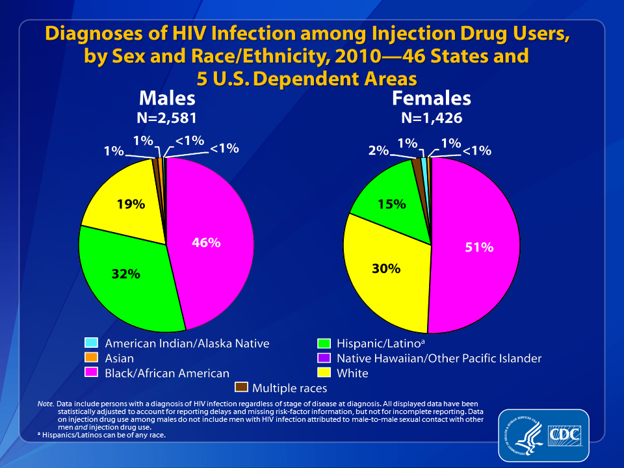
HIV impacts all injection drug users equally, regardless of race or ethnicity
The prevalence of HIV among Hispanic and African-American IDUs is nearly twice as high as it is for Caucasians¹
Source: CDC. (2012). HIV surveillance in injection drug users (through 2010). Available online at: http://www.cdc.gov/hiv/idu/resources/slides
¹CDC. (2009). HIV infection and HIV-Associated Behaviors Among Injecting Drug Users. Morbidity and Mortality Weekly Report, 61(08): 133-138. Available from: http://www.cdc.gov/mmwr/preview/mmwrhtml/mm6108a1.htm
Syringe Services Programs: Myth vs. Fact
Notes:
¹CDC. (2009). HIV infection and HIV-Associated Behaviors Among Injecting Drug Users. Morbidity and Mortality Weekly Report, 61(08): 133-138. Available from: http://www.cdc.gov/mmwr/preview/mmwrhtml/mm6108a1.htm

Slide 18
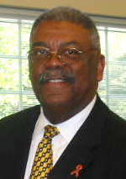
HIV impacts all injection drug users equally, regardless of race or ethnicity
The prevalence of HIV among Hispanic and African-American IDUs is nearly twice as high as it is for Caucasians¹
Expert Observation:
“As the Chairman of the National Black Leadership Commission on AIDS Inc., and the resident of a state with a sizeable Latino community, I have personally witnessed these disproportionate and devastating results.”
- Reverend Dr. W. James Favorite, Senior Pastor of Beulah Baptist Institutional Church and Chair of the Black Leadership Commission on AIDS of Tampa Bay
¹CDC. (2009). HIV infection and HIV-Associated Behaviors Among Injecting Drug Users. Morbidity and Mortality Weekly Report, 61(08): 133-138. Available from: http://www.cdc.gov/mmwr/preview/mmwrhtml/mm6108a1.htm
Syringe Services Programs: Myth vs. Fact
Notes:
¹CDC. (2009). HIV infection and HIV-Associated Behaviors Among Injecting Drug Users. Morbidity and Mortality Weekly Report, 61(08): 133-138. Available from: http://www.cdc.gov/mmwr/preview/mmwrhtml/mm6108a1.htm

Slide 19
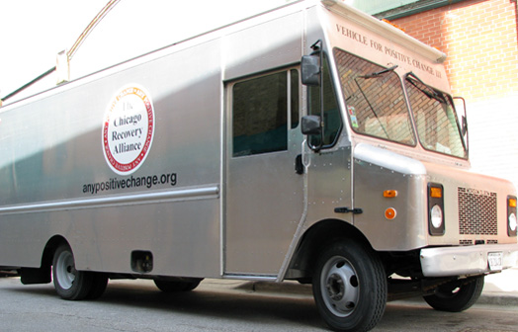
HIV impacts all injection drug users equally, regardless of race or ethnicity
SSPs help reduce health disparities among IDUs by increasing access to health services
SSPs represent a critical tool for minimizing HIV risks and addressing health disparities by reaching the IDU community with vital syringe and health services.¹
¹amfAR, Federal Funding for Syringe Services Programs: Saving Money, Promoting Public Safety, and Improving Public Health. Available at: http://www.amfar.org/uploadedFiles/_amfarorg/Articles/On_The_Hill/2013/issue-brief-federal-funding-for-syringe-service-programs.pdf
²Available at: http://news.medill.northwestern.edu/chicago/news.aspx?id=86315
Source: Medline Reports Chicago²
Syringe Services Programs: Myth vs. Fact
Notes:
¹amfAR, Federal Funding for Syringe Services Programs: Saving Money, Promoting Public Safety, and Improving Public Health. Available at: http://www.amfar.org/uploadedFiles/_amfarorg/Articles/On_The_Hill/2013/issue-brief-federal-funding-for-syringe-service-programs.pdf
²Available at: http://news.medill.northwestern.edu/chicago/news.aspx?id=86315

Slide 20
SSPs do not enjoy broad popular and professional support
State, local, and faith-based organizations around the country already support SSPs
The following organizations support SSPs:
American Academy of Family Physicians
American Academy of Pediatrics
American Bar Association
American Medical Association
American Public Health Association
American Society of Addiction Medicine
International Red Cross-Red Crescent Society
Latino Commission on AIDS
NAACP
National Academy of Sciences
National Black Police Association
National Institute on Drug Abuse
Office of National Drug Control Policy
Presidential Advisory Committee on AIDS
US Conference of Mayors
World Bank
World Health Organization
SSPs also enjoy support from faith communities, including:
Central Conference of American Rabbis
Episcopal Church
National Council on Jewish Women
Presbyterian Church of the United States
Society of Christian Ethics
Union for Reform Judaism
Unitarian Universalist Association
United Church of Christ
Syringe Services Programs: Myth vs. Fact

Slide 21
SSPs do not enjoy broad popular and professional support
State, local, and faith-based organizations around the country already support SSPs
Expert Observation:
"Syringe decriminalization and exchange is ...an issue of compassion and justice... As people of faith, we are called to be the embodiment of that compassion and instruments of that justice in this world to offer an eternal hope. The hope that someone may live another day. The hope that they may be reconciled with their family. The hope that they can live a life free of disease. The hope that they might choose to find treatment. The hope that with that one more day, they might find their own hope for a future outside of their addiction."
- Pastor James Sizemore, Lead Pastor, Catalyst Community Church, Fayetteville, North Carolina
Syringe Services Programs: Myth vs. Fact

Slide 22
Lifting the ban on federal funding in 2009 did not make a difference
Lifting the ban on federal funding, even for a short time, positively affected SSPs around the country
In 2009, Congress removed a 21-year prohibition on the use of federal funds to support SSPs.¹ Two years later, Congress re-imposed the ban on federal funding for SSPs.²
While the ban was lifted, federal dollars were used to support SSPs in California, Connecticut, Delaware, Illinois, Massachusetts, Minnesota, New Jersey, New Mexico, New York, Puerto Rico, Vermont, and Washington.³
These dollars were used to: expand service hours, provide services in new locations, and provide additional services such as case management and overdose prevention services.
¹Consolidated Appropriations Act, 2010. Public law 111-117. (December 16, 2009. Sections 505 and 810.) Available at: http://www.gpo.gov/fdsys/pkg/PLAW-111publ117/pdf/PLAW-111publ117.pdf.
²Consolidated Appropriations Act, 2012. Public law 112-74. (December 23, 2011. Section 523.) Available at: http://www.gpo.gov/fdsys/pkg/PLAW-112publ74/pdf/PLAW-112publ74.pdf.
³ Personal communication, state agency officials.
Syringe Services Programs: Myth vs. Fact
Notes:
¹Consolidated Appropriations Act, 2010. Public law 111-117. (December 16, 2009. Sections 505 and 810.) Available at: http://www.gpo.gov/fdsys/pkg/PLAW-111publ117/pdf/PLAW-111publ117.pdf.
²Consolidated Appropriations Act, 2012. Public law 112-74. (December 23, 2011. Section 523.) Available at: http://www.gpo.gov/fdsys/pkg/PLAW-112publ74/pdf/PLAW-112publ74.pdf.
³ Personal communication, state agency officials.

Slide 23
Lifting the ban on federal funding in 2009 did not make a difference
Lifting the ban on federal funding, even for a short time, positively affected SSPs around the country
Expert Observation:
"The reinstatement of the ban had several immediate effects. The State of New Jersey stopped any support for [SSPs] in December 2011 because most of the state prevention funding is federal dollars…The second effect has been an increased reluctance on the part of foundations and other funders to support our [SSPs]. The ban is sometimes perceived as a judgment of the effectiveness of [SSPs] rather than the political maneuver that it really is. In New Jersey, we fought for over 20 years to get the legislation passed to set these programs up and after almost 5 years of overwhelming success the programs are all in danger of closing because of lack of funds."
- Bob Baxter, Director of Addiction and Educational Services, NJCRI
“Since our local health department does not fund the personnel costs associated with our harm reduction work on the southeast side of Chicago, the biggest impact of the impending reinstatement of the federal ban will likely be felt by IDUs at risk for HIV/HCV and drug overdose in this region."
- Antonio Jimenez, Project Director, SSP Initiative, UIC
Syringe Services Programs: Myth vs. Fact

Slide 24
Lifting the current ban on federal funding will not make a difference
Lifting the ban on federal funding is important to maintain SSPs
Federal dollars open doors. Federal funding is often perceived by other donors as a "seal of approval,” leading to new funding streams. Federal grantees can also receive extensive technical assistance at no cost.¹
State and local budgets are dwindling. This means that federal dollars are important in maintaining and expanding existing services.
It's about local control. State and local decision makers should have flexibility in the use of federal funds to address local health concerns.
¹Bob Baxter, Director of Addiction and Educational Services, NJCRI
Syringe Services Programs: Myth vs. Fact
Notes:
¹Bob Baxter, Director of Addiction and Educational Services, NJCRI

Slide 25

Lifting the current ban on federal funding will not make a difference
Lifting the ban on federal funding is important to maintain SSPs
Expert Observation:
“By restoring the ban on federal funding for syringe exchange, members of Congress undoubtedly believed they were striking a blow against drug use. As extensive experience has shown, nothing could be further from the truth. By withholding funding for syringe exchange, Congress has made our communities less safe, made police officers and medical responders unsafe, undermined a vital bridge to drug treatment, and hindered national efforts to address public health problems such as HIV and hepatitis C.”
- Chief James Pugel, Seattle Police Department
Syringe Services Programs: Myth vs. Fact

Slide 26
Lifting the current ban on federal funding will not make a difference
Lifting the ban on federal funding is important to maintain SSPs
Expert Observation:
“Ending the ban on the use of federal funds for syringe services programs remains an urgent priority for the public health, HIV/AIDS, viral hepatitis, and harm reduction communities. Sustaining and expanding access to sterile syringes and comprehensive services for people who inject drugs is of vital importance to disease control efforts, as state and local jurisdictions struggle to adequately resource these programs as they confront new challenges and growing demand. We are extremely concerned that the FY 2012 federal funding ban may worsen access to HIV testing and prevention interventions for this key risk group, exacerbate HIV-related racial and ethnic health disparities among injection drug users, and jeopardize our ability to meet the goals of the [National HIV/AIDS Strategy].”
- PACHA Syringe Exchange Letter to President Obama, May 17, 2012¹
¹Presidential Advisory Council on HIV/AIDS. (2012). Syringe Exchange Letter to President Obama. Available at: http://aids.gov/federal-resources/pacha/meetings/2012/may-2012-letter-to-president.pdf.
Syringe Services Programs: Myth vs. Fact
Notes:
¹Presidential Advisory Council on HIV/AIDS. (2012). Syringe Exchange Letter to President Obama. Available at: http://aids.gov/federal-resources/pacha/meetings/2012/may-2012-letter-to-president.pdf.

Slide 27
Support of SSPs is unrealistic given the current fiscal crisis
Lifting the ban on federal funding of SSPs saves money and lives without costing a dime
The cost of lifting the ban on federal funding is nothing.
It simply allows localities to spend their federal prevention dollars as they see fit.
SSPs are highly cost-effective, saving an average of $3-7 for every $1 spent. Supporting cost-effective programs is especially important during fiscal crises.¹
¹Nguyen, T. Q., Weir, B. W., Pinkerton, S. D., Des Jarlais, D.C., & Holtgrave, D. (2012). Increasing investment in syringe exchange is cost-saving HIV prevention: modeling hypothetical syringe coverage levels in the United States (MOAE0204). Presented at the XIX International AIDS Conference, Washington, D.C. Session available online at http://pag.aids2012.org/PAGMaterial/PPT/1064_1420/tnsepcostsavingiac2012.pptx..
Syringe Services Programs: Myth vs. Fact
Notes:
¹Nguyen, T. Q., Weir, B. W., Pinkerton, S. D., Des Jarlais, D.C., & Holtgrave, D. (2012). Increasing investment in syringe exchange is cost-saving HIV prevention: modeling hypothetical syringe coverage levels in the United States (MOAE0204). Presented at the XIX International AIDS Conference, Washington, D.C. Session available online at http://pag.aids2012.org/PAGMaterial/PPT/1064_1420/tnsepcostsavingiac2012.pptx.

Slide 28
Due to the success of SSPs, our work is done
Our work is far from over
SSPs do not reach all IDUs. As a result, injection drug use still causes 14% of new HIV infections among women and 7-11% of new infections among men.¹
There are 3.2 million Americans living with hepatitis C, the leading cause of liver transplant in the US.^{2,3}
More Americans ages 25 to 64 lose their lives to drug overdose than motor-vehicle crashes.⁴
¹CDC. (2012). HIV Surveillance in Injection Drug Users (through 2010). Available at: http://www.cdc.gov/hiv/idu/resources/slides/slides/HIV_injection_drug_users.pdf.
²CDC. (2012). Hepatitis C for Health Professionals: Overview and Statistics. Available at: http://www.cdc.gov/hepatitis/HCV/HCVfaq.htm.
³National Digestive Diseases Information Clearinghouse. (2012). Liver Transplantation. Available at: http://digestive.niddk.nih.gov/ddiseases/pubs/livertransplant/
⁴CDC. (2013). Drug Overdose in the United States: Fact Sheet. Available at: http://www.cdc.gov/homeandrecreationalsafety/overdose/facts.html
Syringe Services Programs: Myth vs. Fact
Notes:
¹CDC. (2012). HIV Surveillance in Injection Drug Users (through 2010). Available at: http://www.cdc.gov/hiv/idu/resources/slides/slides/HIV_injection_drug_users.pdf.
²CDC. (2012). Hepatitis C for Health Professionals: Overview and Statistics. Available at: http://www.cdc.gov/hepatitis/HCV/HCVfaq.htm.
³National Digestive Diseases Information Clearinghouse. (2012). Liver Transplantation. Available at: http://digestive.niddk.nih.gov/ddiseases/pubs/livertransplant/
⁴CDC. (2013). Drug Overdose in the United States: Fact Sheet. Available at: http://www.cdc.gov/homeandrecreationalsafety/overdose/facts.html

Slide 29
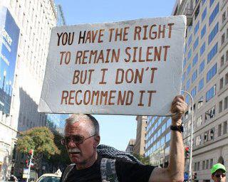
Due to the success of SSPs, our work is done
YOU can help
Learn more: visit amfar.org/endtheban and theexchange.amfar.org. Watch the ten-minute movie, “The Exchange,” as well as the shorts, “Dollars & Sense,” “Race & Drugs,” and “Addiction & You.”
Sign the petition:
https://www.surveymonkey.com/s/EndTheBan
Get the word out: host a film screening, post the links on facebook, send a tweet, and share on listservs.
Syringe Services Programs: Myth vs. Fact

Slide 30

Due to the success of SSPs, our work is done
YOU can help
Call your representative in Congress as an individual or as a group event.
Write an op-ed, blog post, or letter to your representative in Congress.
Visit your congressional office, either in-state or in DC.
Work with your local SSP: volunteer, donate, ask them to speak to your group (go to www.nasen.org to find the SSP nearest you). Ask your representative in Congress to visit the local SSP and see it for themselves.
Not sure how? Go to www.amfar.org/endtheban.
Students with Senator Blumenthal (CT).
Syringe Services Programs: Myth vs. Fact

Slide 31
SSPs FACTS Summary
SSPs save lives by preventing the spread of HIV and by serving as a bridge to other services, including drug treatment.
SSPs are good for everyone: IDUs, first-responders, law enforcement, and general public safety.
In light of prescription drug misuse and its expansion into injection drugs, the need for SSPs is greater than ever.
SSPs can reduce health disparities between racial and ethnic groups by increasing access to health care.
SSPs enjoy broad support from medical, legal, public health, faith, and local communities.
It’s a matter of local control. State and local decision makers should have flexibility in the use of federal funds to address local health concerns.
Lifting the ban costs nothing and saves money.
Syringe Services Programs: Myth vs. Fact

